Slide 1
Uva 10672
Marbles on a Tree
Time: 3 seconds

Slide 2
Problem Description
n boxes are placed on the vertices of a rooted tree, which are numbered from 1 to n, 1 ≤ n ≤ 10000.
Each box is either empty or contains a number of marbles; the total number of marbles is n.
The task is to move the marbles such that each box contains exactly one marble.
This is to be accomplished be a sequence of moves; each move consists of moving one marble to a box at an adjacent vertex.
What is the minimum number of moves required to achieve the goal?

Slide 3
Input
The input contains a number of cases.
Each case starts with the number n followed by n lines.
Each line contains at least three numbers which are:
v: the number of a vertex
followed by the number of marbles originally placed at vertex v
d: followed by a number d which is the number of children of v, followed by d numbers giving the identities of the children of v.
The input is terminated by a case where n = 0 and this case should not be processed.

Slide 4
Output
For each case in the input, output the smallest number of moves of marbles resulting in one marble at each vertex of the tree.

Slide 5

Sample Input / Output
number of boxes
9
1 2 3 2 3 4
2 1 0
3 0 2 5 6
4 1 3 7 8 9
5 3 0
6 0 0
7 0 0
8 2 0
9 0 0
7
vertex
number of children vertices
number of marbles
1
2
2
3
4
1
0
1
2
1
2
5
6
7
8
9
3
0
0
2
2
0

Slide 6
Solution - from leaves to root
2
+0
1
0
1
+2
-1
-1
+1
-1
0
+6
3
0
0
2

Slide 7
Solution - from leaves to root
2
+0
+0
-1
-1
+0
1
0
1
+2
-1
-1
+1
-1
+1
3
0
0
2
0
6+1=7

Slide 8
Sample Input / Output
number of boxes
9
1 0 3 2 3 4
2 0 0
3 0 2 5 6
4 9 3 7 8 9
5 0 0
6 0 0
7 0 0
8 0 0
9 0 0
14
vertex
number of following vertices
number of marbles
1
0
2
3
4
0
0
9
5
6
7
8
9
0
0
0
0
0

Slide 9
Solution- from leaves to root
0
-1
0
0
9
-1
-1
-1
-1
-1
+6
0
0
0
0
0

Slide 10
Solution- from leaves to root
0
-1
+5
-3
0
-1
+8
0
9
-1
-1
-1
-1
-1
0
0
0
0
0
+6+8=14

Slide 11
Sample Input / Output
number of boxes
6
5 0 2 2 3
2 2 0
3 0 3 4 1 6
4 2 0
1 2 0
6 0 0
14
vertex
number of following vertices
number of marbles

Slide 12
Example (1)
9
2 0 0
3 0 2 5 6
1 0 3 2 3 4
4 9 3 7 8 9
5 0 0
6 0 0
7 0 0
8 0 0
9 0 0
No. | 1 | 2 | 3 | 4 | 5 | 6 | 7 | 8 | 9
Marble Number | 0 | 0 | 0 | 0 | 0 | 0 | 0 | 0 | 0
Parent | 0 | 0 | 0 | 0 | 0 | 0 | 0 | 0 | 0
Out Degree | 0 | 0 | 0 | 0 | 0 | 0 | 0 | 0 | 0
No. | 1 | 2 | 3 | 4 | 5 | 6 | 7 | 8 | 9
Marble Number | 0 | 0 | 0 | 0 | 0 | 0 | 0 | 0 | 0
Parent | 0 | 0 | 0 | 0 | 0 | 0 | 0 | 0 | 0
Out Degree | 0 | 0 | 0 | 0 | 0 | 0 | 0 | 0 | 0

Slide 13
Example (2)
9
2 0 0
3 0 2 5 6
1 0 3 2 3 4
4 9 3 7 8 9
5 0 0
6 0 0
7 0 0
8 0 0
9 0 0
No. | 1 | 2 | 3 | 4 | 5 | 6 | 7 | 8 | 9
Marble Number | 0 | 0 | 0 | 0 | 0 | 0 | 0 | 0 | 0
Parent | 0 | 0 | 0 | 0 | 0 | 0 | 0 | 0 | 0
Out Degree | 0 | 0 | 0 | 0 | 0 | 0 | 0 | 0 | 0
No. | 1 | 2 | 3 | 4 | 5 | 6 | 7 | 8 | 9
Marble Number | 0 | 0 | 0 | 0 | 0 | 0 | 0 | 0 | 0
Parent | 0 | 0 | 0 | 0 | 3 | 3 | 0 | 0 | 0
Out Degree | 0 | 0 | 2 | 0 | 0 | 0 | 0 | 0 | 0

Slide 14
Example (3)
9
2 0 0
3 0 2 5 6
1 0 3 2 3 4
4 9 3 7 8 9
5 0 0
6 0 0
7 0 0
8 0 0
9 0 0
No. | 1 | 2 | 3 | 4 | 5 | 6 | 7 | 8 | 9
Marble Number | 0 | 0 | 0 | 0 | 0 | 0 | 0 | 0 | 0
Parent | 0 | 0 | 0 | 0 | 3 | 3 | 0 | 0 | 0
Out Degree | 0 | 0 | 2 | 0 | 0 | 0 | 0 | 0 | 0
No. | 1 | 2 | 3 | 4 | 5 | 6 | 7 | 8 | 9
Marble Number | 0 | 0 | 0 | 0 | 0 | 0 | 0 | 0 | 0
Parent | 0 | 1 | 1 | 1 | 3 | 3 | 0 | 0 | 0
Out Degree | 3 | 0 | 2 | 0 | 0 | 0 | 0 | 0 | 0

Slide 15
Example (4)
9
2 0 0
3 0 2 5 6
1 0 3 2 3 4
4 9 3 7 8 9
5 0 0
6 0 0
7 0 0
8 0 0
9 0 0
No. | 1 | 2 | 3 | 4 | 5 | 6 | 7 | 8 | 9
Marble Number | 0 | 0 | 0 | 0 | 0 | 0 | 0 | 0 | 0
Parent | 0 | 1 | 1 | 1 | 3 | 3 | 0 | 0 | 0
Out Degree | 3 | 0 | 2 | 0 | 0 | 0 | 0 | 0 | 0
No. | 1 | 2 | 3 | 4 | 5 | 6 | 7 | 8 | 9
Marble Number | 0 | 0 | 0 | 9 | 0 | 0 | 0 | 0 | 0
Parent | 0 | 1 | 1 | 1 | 3 | 3 | 4 | 4 | 4
Out Degree | 3 | 0 | 2 | 3 | 0 | 0 | 0 | 0 | 0

Slide 16
Example (5)
9
2 0 0
3 0 2 5 6
1 0 3 2 3 4
4 9 3 7 8 9
5 0 0
6 0 0
7 0 0
8 0 0
9 0 0
No. | 1 | 2 | 3 | 4 | 5 | 6 | 7 | 8 | 9
Marble Number | 0 | 0 | 0 | 9 | 0 | 0 | 0 | 0 | 0
Parent | 0 | 1 | 1 | 1 | 3 | 3 | 4 | 4 | 4
Out Degree | 3 | 0 | 2 | 3 | 0 | 0 | 0 | 0 | 0
No. | 1 | 2 | 3 | 4 | 5 | 6 | 7 | 8 | 9
Marble Number | 0 | 0 | 0 | 9 | 0 | 0 | 0 | 0 | 0
Parent | 0 | 1 | 1 | 1 | 3 | 3 | 4 | 4 | 4
Out Degree | 3 | 0 | 2 | 3 | 0 | 0 | 0 | 0 | 0

Slide 17
Example (6)
No. | 1 | 2 | 3 | 4 | 5 | 6 | 7 | 8 | 9
Marble Number | 0 | 0 | 0 | 9 | 0 | 0 | 0 | 0 | 0
Parent | 0 | 1 | 1 | 1 | 3 | 3 | 4 | 4 | 4
Out Degree | 3 | 0 | 2 | 3 | 0 | 0 | 0 | 0 | 0
ans += abs(MarbleNumber[u] - 1);
ans+=6
ans=6
queue
u
2 5 6 7 8 9

Slide 18
Example (7)
-1
-1
-1
-1
-1
-1
No. | 1 | 2 | 3 | 4 | 5 | 6 | 7 | 8 | 9
Marble Number | 0 | 0 | 0 | 9 | 0 | 0 | 0 | 0 | 0
Parent | 0 | 1 | 1 | 1 | 3 | 3 | 4 | 4 | 4
Out Degree | 3 | 0 | 2 | 3 | 0 | 0 | 0 | 0 | 0
No. | 1 | 2 | 3 | 4 | 5 | 6 | 7 | 8 | 9
Marble Number | -1 | 1 | -2 | 6 | 1 | 1 | 1 | 1 | 1
Parent | 0 | 1 | 1 | 1 | 3 | 3 | 4 | 4 | 4
Out Degree | 2 | 0 | 0 | 0 | 0 | 0 | 0 | 0 | 0

Slide 19
Example (8)
No. | 1 | 2 | 3 | 4 | 5 | 6 | 7 | 8 | 9
Marble Number | -1 | 1 | -2 | 6 | 1 | 1 | 1 | 1 | 1
Parent | 0 | 1 | 1 | 1 | 3 | 3 | 4 | 4 | 4
Out Degree | 2 | 0 | 0 | 0 | 0 | 0 | 0 | 0 | 0
ans += abs(MarbleNumber[u] - 1);
ans+=8
ans=14
queue
u
4 3

Slide 20
Example (8)
-3
+5
No. | 1 | 2 | 3 | 4 | 5 | 6 | 7 | 8 | 9
Marble Number | -1 | 1 | -2 | 6 | 1 | 1 | 1 | 1 | 1
Parent | 0 | 1 | 1 | 1 | 3 | 3 | 4 | 4 | 4
Out Degree | 2 | 0 | 0 | 0 | 0 | 0 | 0 | 0 | 0
No. | 1 | 2 | 3 | 4 | 5 | 6 | 7 | 8 | 9
Marble Number | 1 | 1 | 1 | 1 | 1 | 1 | 1 | 1 | 1
Parent | 0 | 1 | 1 | 1 | 3 | 3 | 4 | 4 | 4
Out Degree | 0 | 0 | 0 | 0 | 0 | 0 | 0 | 0 | 0

Slide 21
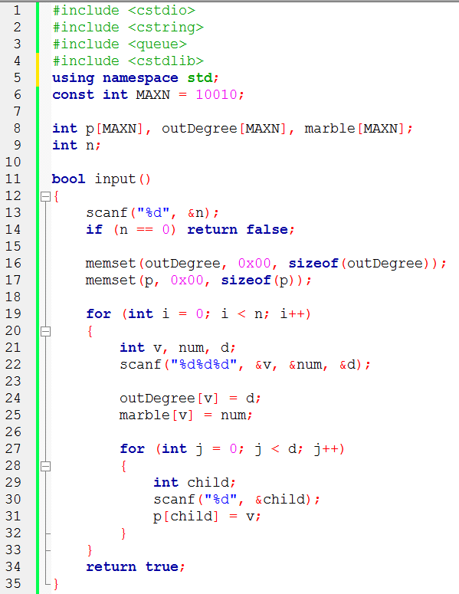

Slide 22
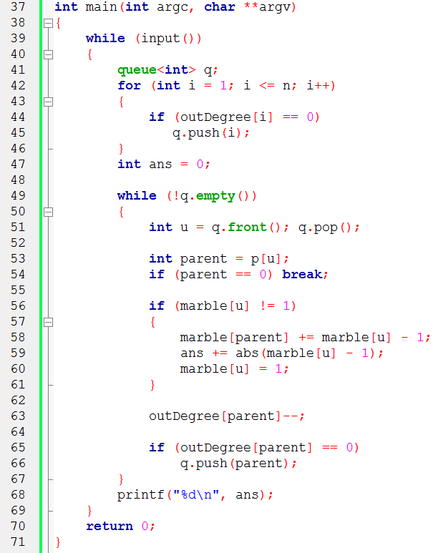
//從leaves 開始
//是root
//沒調整過
//parent degree -1

